Slide 1
Mean-Free-Path Dependence of the Losses From Trapped Magnetic Flux in SRF Cavities
Dan Gonnella
Cornell University
September 14, 2015

Slide 2
Motivation
It is well understood that to achieve optimal Q₀ performance, SRF cavities should be cooled in as small magnetic fields as possible.
A rule of thumb is given in Padamsee: residual resistance will increase by 0.3 nΩ per mG of magnetic field.
Cavity Q₀ | Q₀ in 10 mG, 0.3 nΩ/mG | ΔP_{diss} (0.3 nΩ/mG) | Q₀ in 10 mG, 1 nΩ/mG | ΔP_{diss} (1 nΩ/mG)
1x10¹⁰ | 9x10⁹ | 11% | 7x10⁹ | 40%
2.7x10¹⁰ | 2.1x10¹⁰ | 29% | 1.4x10¹⁰ | 93%
At lower Q₀’s, the exact sensitivity didn’t matter as much
Notes:
Add two deltas relative to original Q

Slide 3
Motivation
Now that we are routinely dealing with higher Q₀’s and new cavity preparation techniques:
How does this ratio change depending on cavity preparation/material parameters?
Is there anything different about how doped cavities react to magnetic fields?

Slide 4
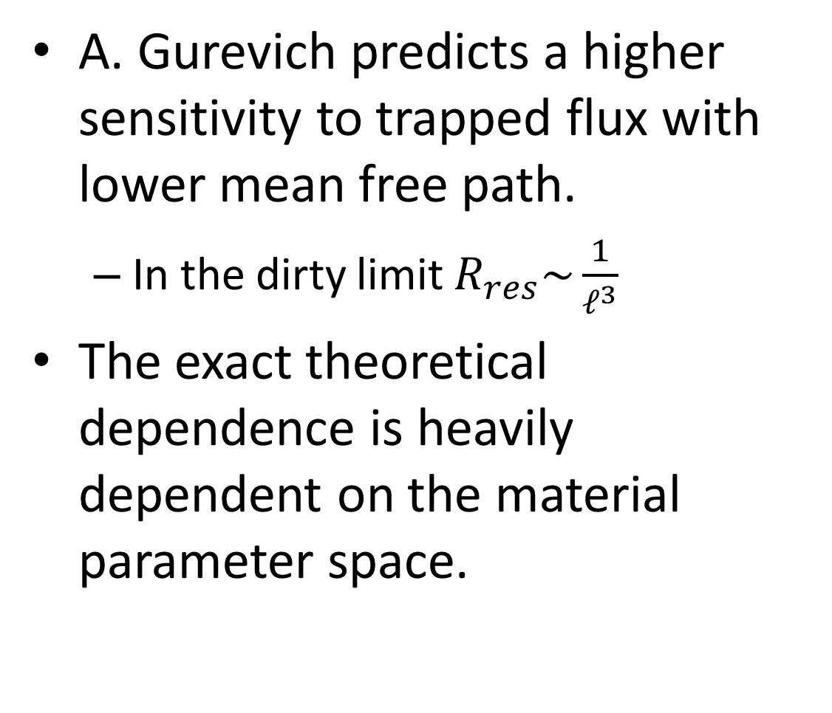
Theoretical Considerations
A. Gurevich predicts a higher sensitivity to trapped flux with lower mean free path.
In the dirty limit $R_{res}\sim \frac{1}{ℓ^{3}}$
The exact theoretical dependence is heavily dependent on the material parameter space.
H(t)
u(z,t)
2ξ
l
λ
A. Gurevich, Vortex hotspots in SRF Cavities. 7th SRF Materials Workshop, Jlab, July 16, 2012

Slide 5
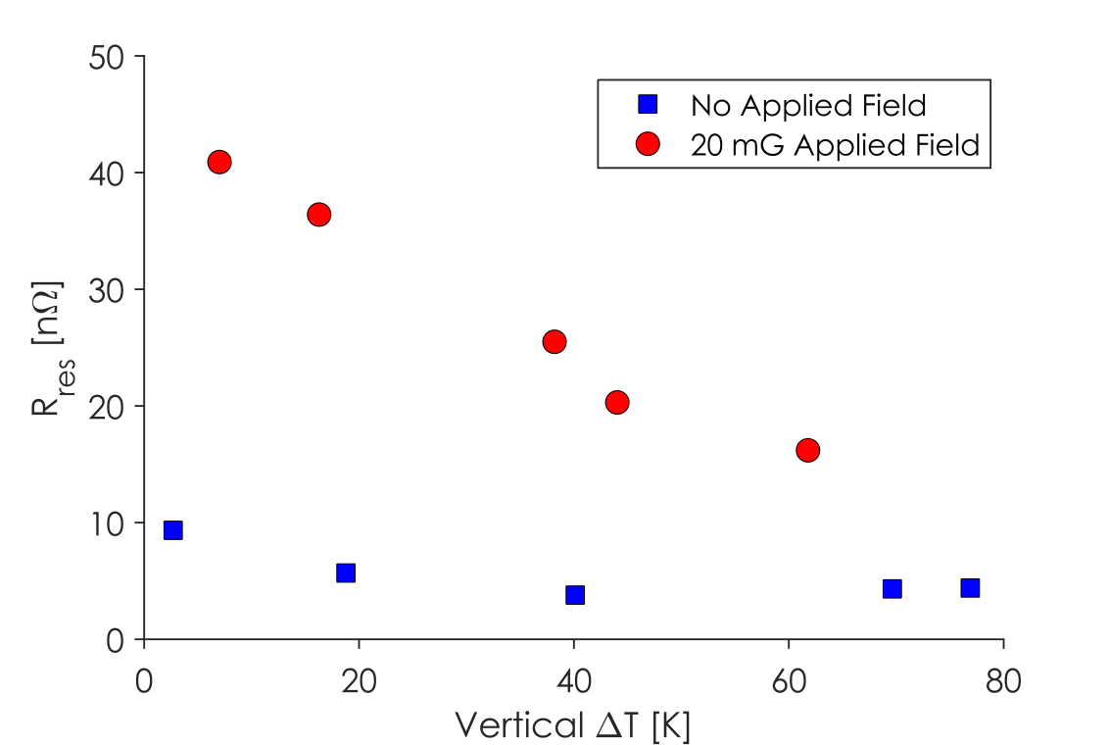
R_{res} vs ΔT
Romanenko et. al. first showed that residual resistance increased in nitrogen-doped cavities and 120ºC baked cavities after a slow cool down.
Recent results at Cornell and FNAL have further expanded upon these initial results.
Larger transverse spatial temperature gradients during cool down lead to more efficient flux expulsion and lower residual resistance.
R_{res} vs ΔT_{vertical} in the Cornell HTC
Large ΔT/Δx → Lower R_{res}
See MOBA08 and MOPB041

Slide 6
How then can we compare cavity sensitivities to magnetic fields while normalizing for cool down parameters?

Slide 7
By normalizing to trapped magnetic flux:
When a cavity becomes superconducting in a magnetic field, some of that field will be trapped in the cavity walls.
This trapped magnetic field directly leads to additional residual resistance.

Slide 8
The Experiment
Want to measure increase in R_{res} due to trapped flux as a function of material properties
3 challenges:
Control flux trapping/measure how much is trapped
Measure R_{res} at low fields
Extract material properties from RF surface impedance measurements

Slide 9
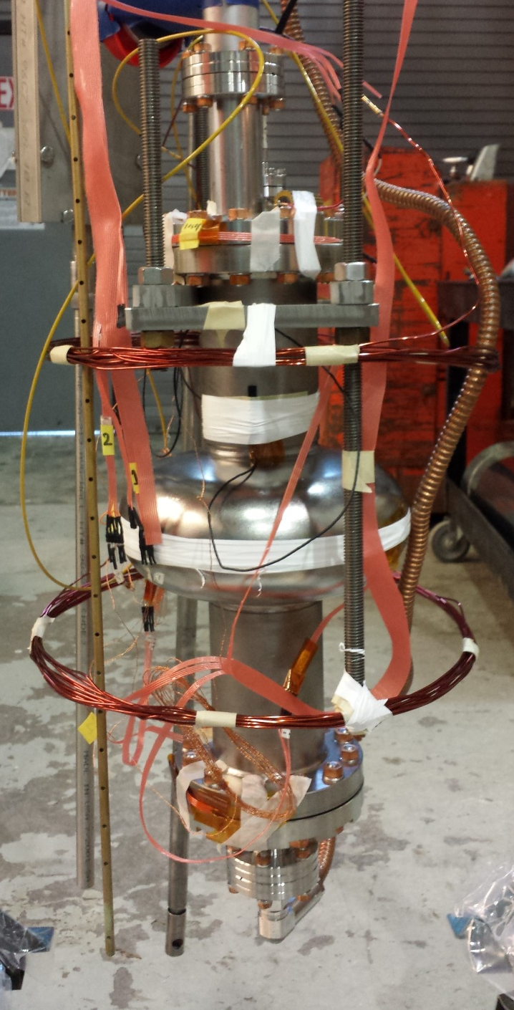
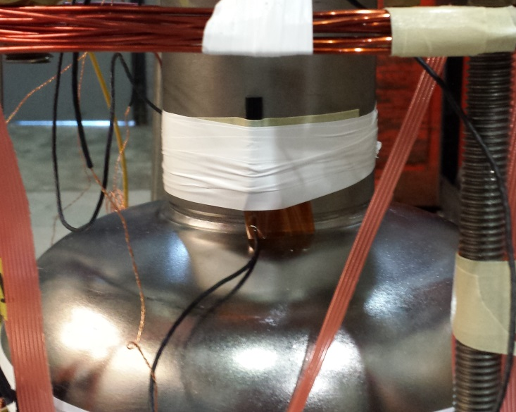
Experimental Setup
Slow Cool
Down System
Temperature Sensors
Fluxgate
Magnetometer
Helmholtz
Coil

Slide 10
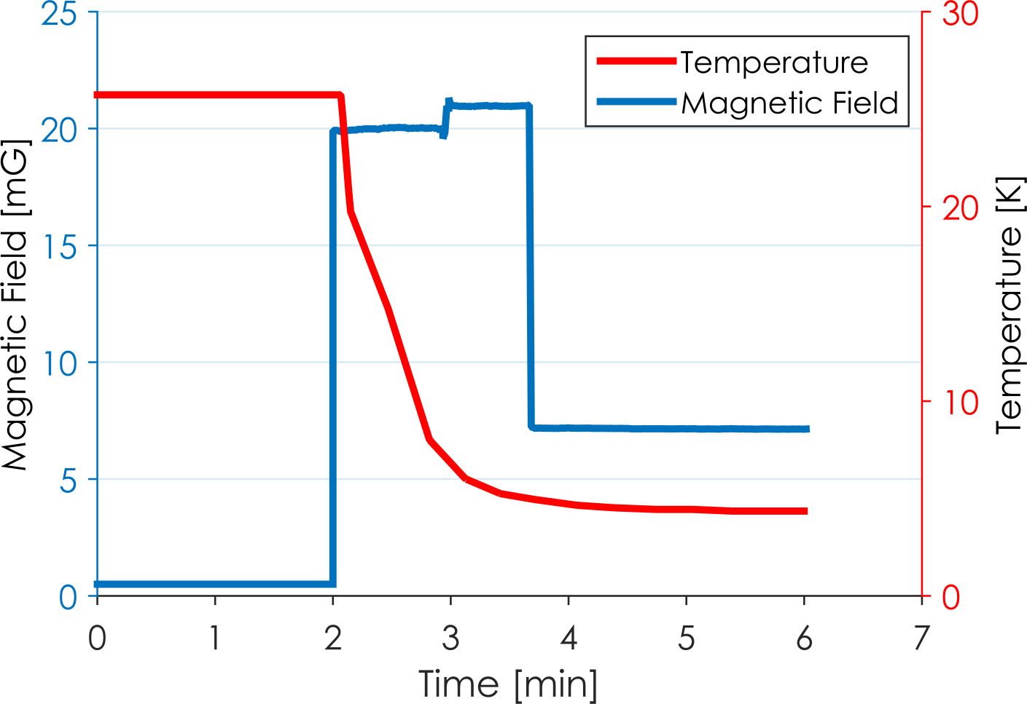
Fluxgate Measurements
External Field On
T_{C}
External Field Off,
Flux Trapped
External Field Off

Slide 11
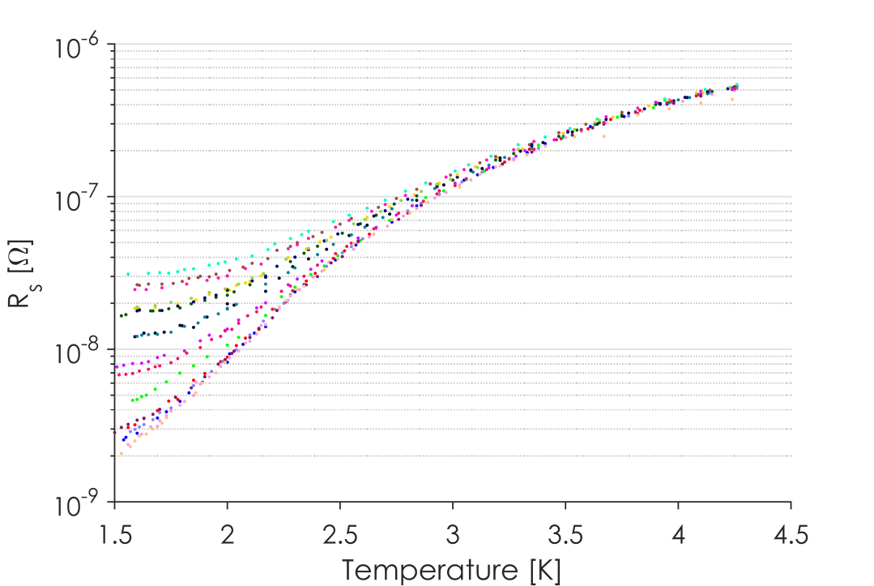
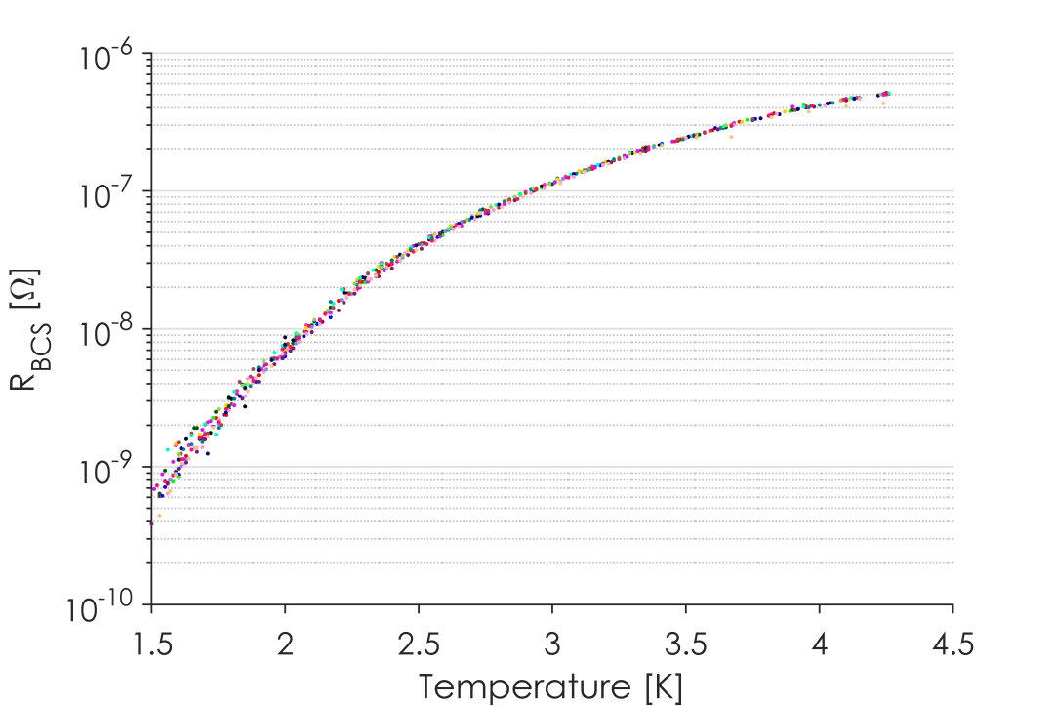
R_{s} vs T
Surface Resistance vs Temperature
BCS Resistance vs Temperature
Spread in R_{s} caused different residual resistances
18 Cool Downs with a variety of trapped magnetic flux
More trapped flux leads to higher surface resistance.
This surface resistance increase is seen only in the temperature independent residual resistance.
Temperature dependent BCS resistance is unaffected by trapped flux.

Slide 12
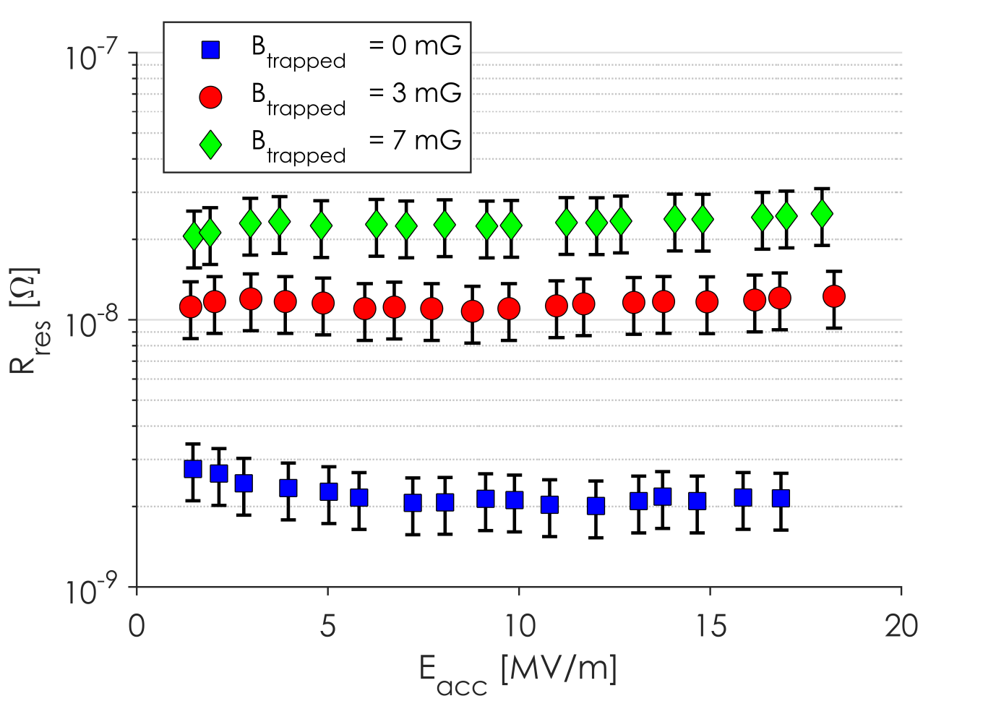
R_{res} vs RF Field
Change in R_{res} due to different trapped flux
Residual resistance from trapped flux is independent of E_{acc} up to medium field

Slide 13
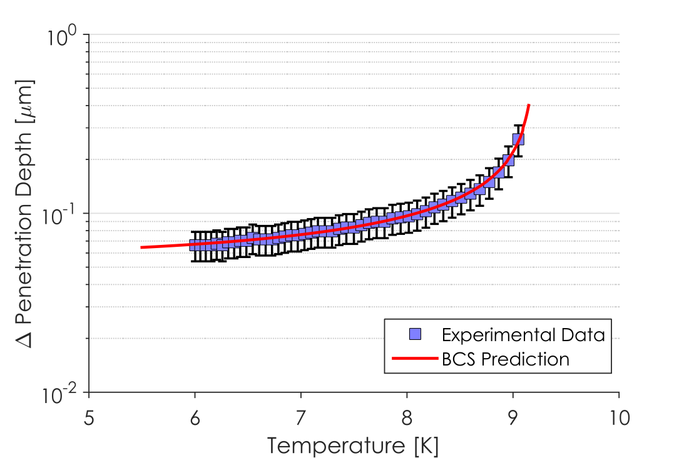
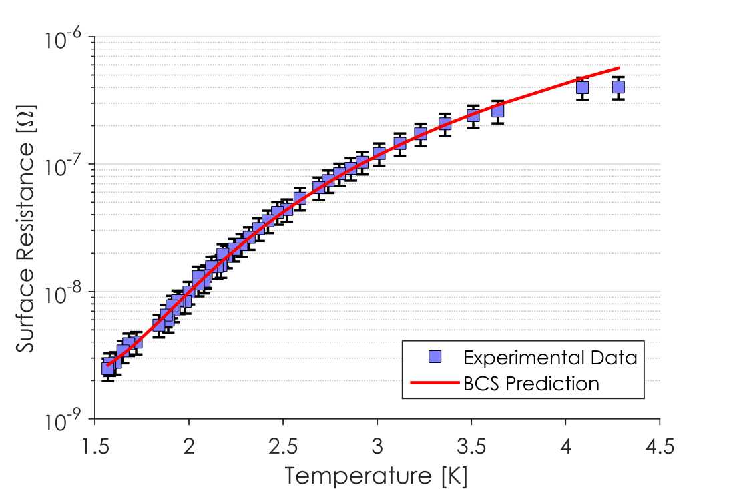
Fitting of BCS Parameters
Penetration Depth vs Temperature
Surface Resistance vs Temperature
Change in penetration depth is computed from change in resonance frequency.
Penetration depth depends strongly on mean free path and T_{c}.
This is fit using BCS theory to extract mean free path holding energy gap and residual resistance constant.
Q₀ is sensitive to energy gap and residual resistance but not mean free path.
Surface resistance vs temperature is fit using BCS theory to extract energy gap and residual resistance holding mean free path constant.
Notes:
Try to color code or clean up

Slide 14
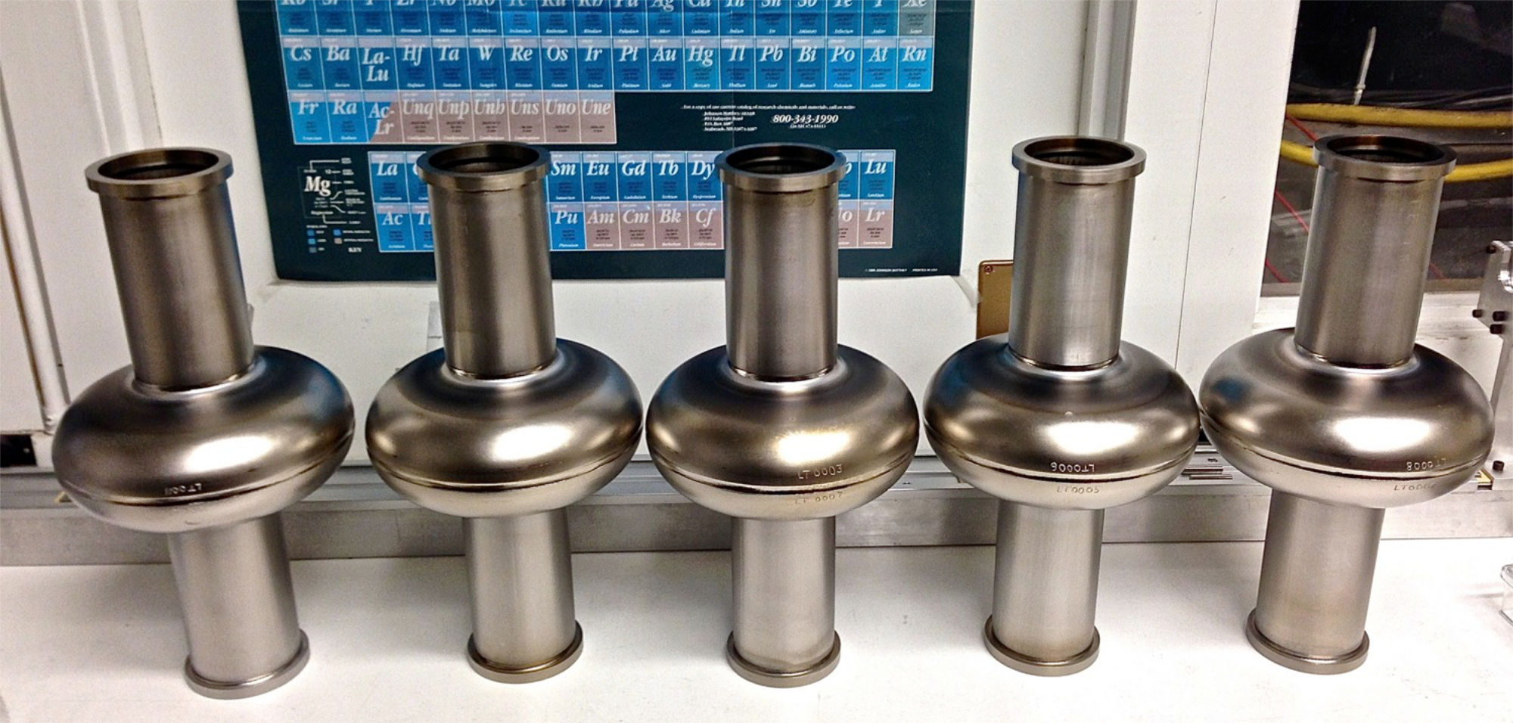
The Experiment
8 single-cell cavities were prepared with a variety of techniques.
6 nitrogen doped cavities of varying doping levels
2 “standard” treated cavities: one EP cavity and an EP+120⁰C baked cavity

Slide 15
The Experiment
Each cavity was cooled in a variety of magnetic fields leading to different amounts of trapped magnetic flux.
Mean free path was extracted for each cavity.
Sensitivity to trapped magnetic flux was found.

Slide 16
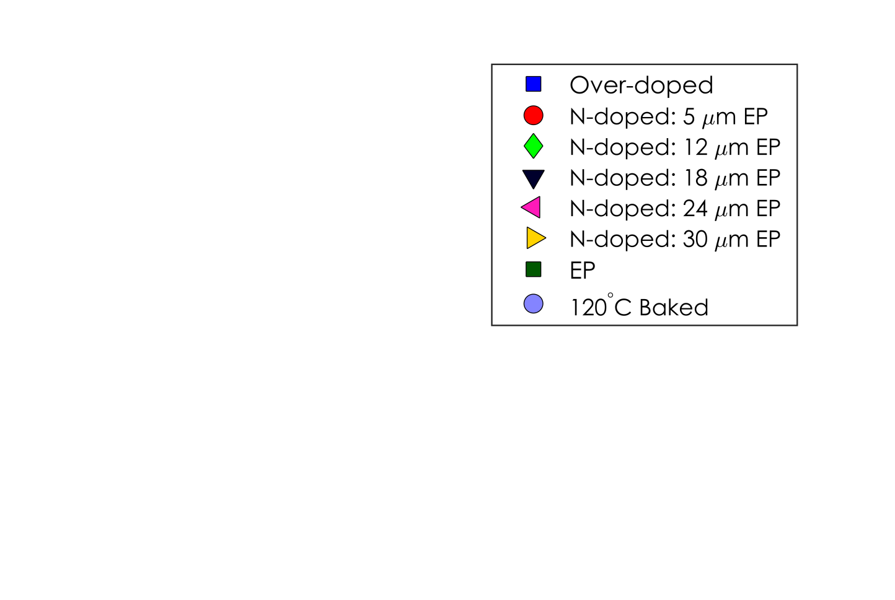
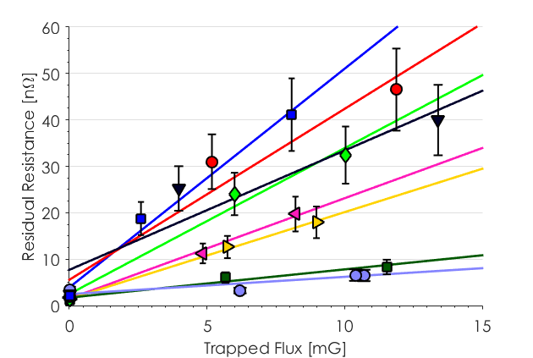
R_{res} vs Trapped Flux
Large spread in slopes
Cavities with different preparations show very different sensitivities to trapped flux!

Slide 17
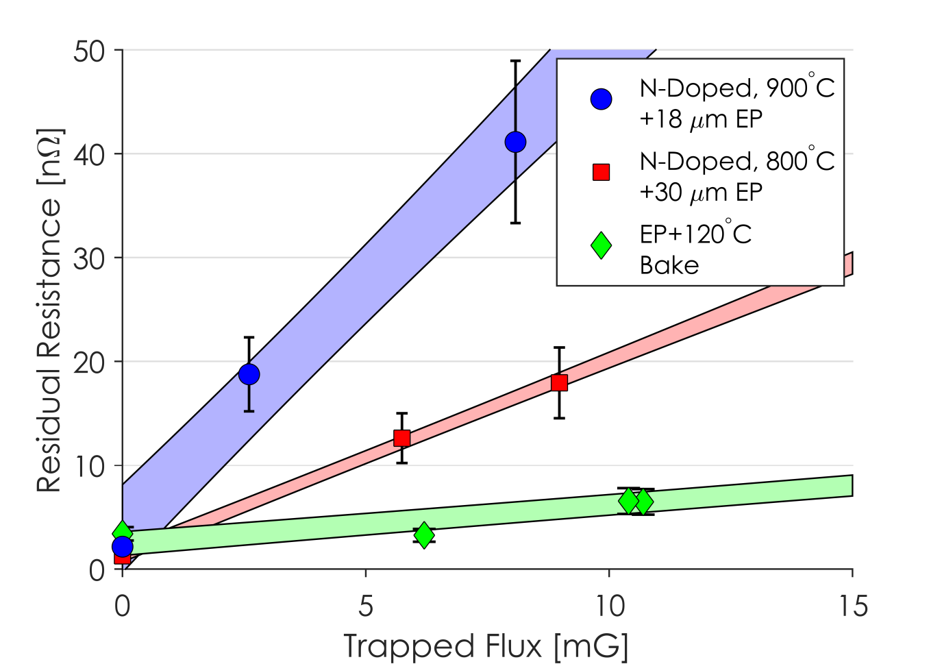
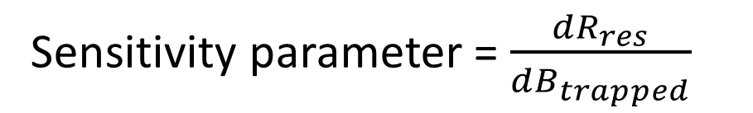
R_{res} vs Trapped Flux
Stronger doping results in a higher sensitivity to trapped flux.
All nitrogen-doped cavities tested showed a higher sensitivity than both the EP and EP+120ºC baked cavities.
Sensitivity parameter = $\frac{dR_{res}}{dB_{trapped}}$

Slide 18
Results
N-Doping Temperature | Cavity | Mean Free Path [nm] | ε/k_{B}T_{c} | Sensitivity to Trapped Flux [nΩ/mG]
800ºC | LT1-2 | 19±6 | 1.87±0.03 | 3.7±0.9
 | LT1-3 | 34±10 | 1.91±0.03 | 3.1±0.5
 | LT1-1 | 39±12 | 1.88±0.03 | 2.5±0.6
 | LT1-4 | 47±14 | 1.89±0.03 | 2.2±0.2
 | LT1-5 | 60±18 | 1.88±0.03 | 1.87±0.08
900ºC | LT1-2 | 6±2 | 2.01±0.03 | 4.7±0.6
 | NR1-3 (EP) | 770±230 | 1.81±0.03 | 0.8±0.1
 | NR1-3 (EP+120ºC) | 120±36† | 1.96±0.03 | 0.6±0.05
† 120ºC bake only affects a fraction of the RF penetration layer – mean free path is found effectively by averaging over the whole RF layer

Slide 19
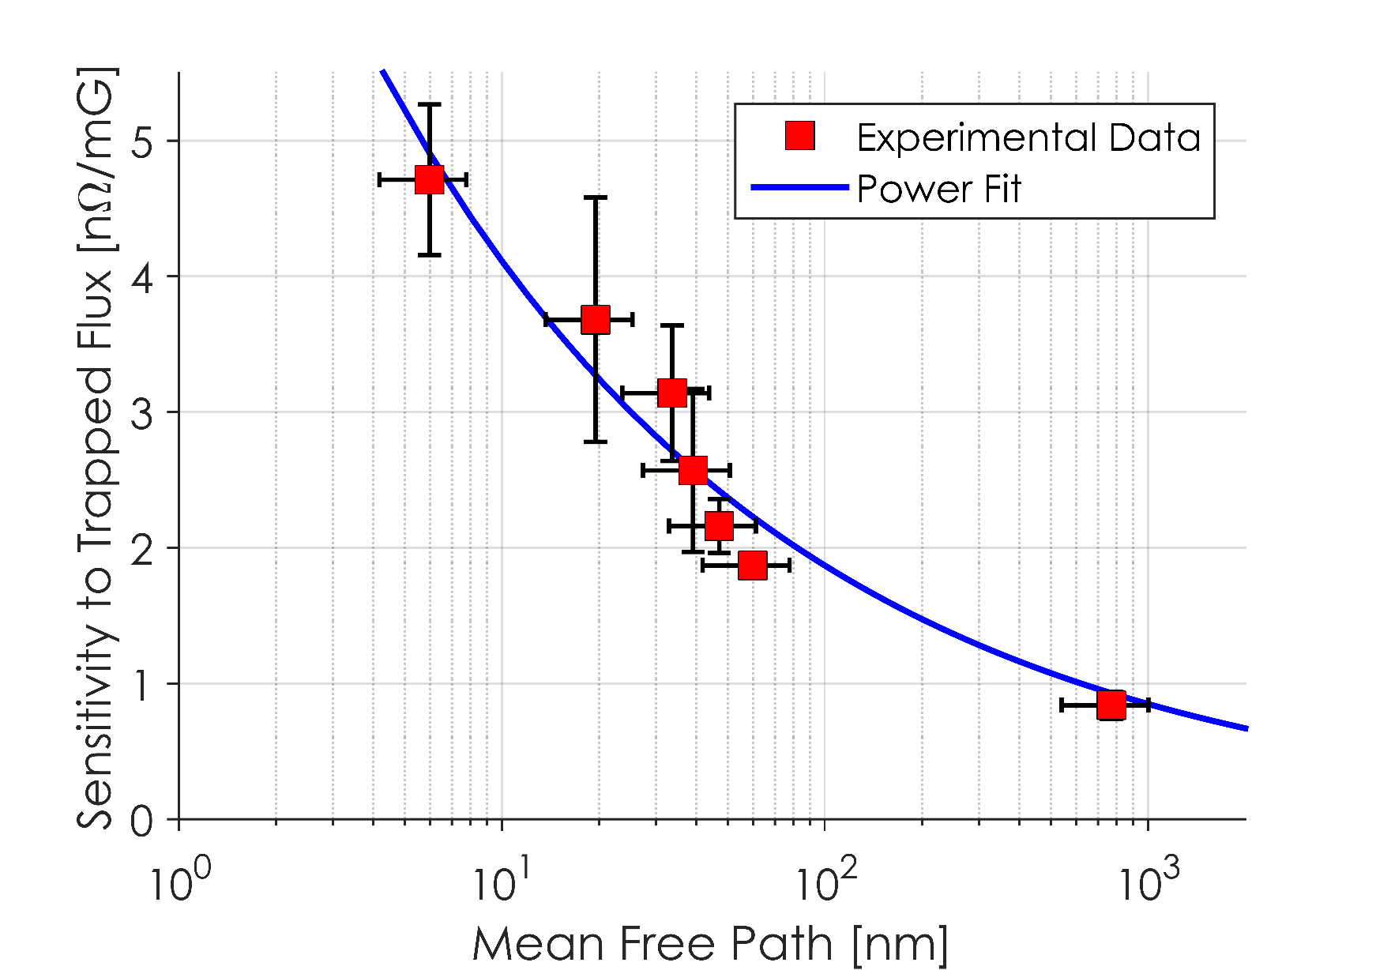
Sensitivity vs MFP
Higher Sensitivity
Dirtier
Smaller mean free path results in higher sensitivity to trapped flux.
Notes:
Take off 120 c try a fit gradient on arrow for doped cavities

Slide 20
Conclusions
This is the first systematic measurement of the dependence of residual resistance sensitivity to trapped magnetic flux on cavity preparation.
Nitrogen-doped cavities have a lower mean free path → higher sensitivity
These measurements explain why slow cool down affects nitrogen-doped cavities so much stronger than “standard” prepared cavities.

